Slide 2







Project (Rowad Masr)
Members:

Slide 3
Project (Rowad Masr)
Members:
Mostafa Nasr
Team leader & supervision

Slide 4
Project (Rowad Masr)
Members:
Ahmed Nashaat Prepare Project Data

Slide 5
Project (Rowad Masr)
Members:
Nada Mohi
Prepare Powerpoint presentation

Slide 6
Project (Rowad Masr)
Members:
Sara Osama
Prepare Oracle data screen shot & writing steps

Slide 7
Project (Rowad Masr)
Members:
Ahmed Omar Oracle steps support

Slide 8
Project (Rowad Masr)
Members:
Ahmed Ali
Support in prepare project data

Slide 9
Project (Rowad Masr)
Members:
Heba Khaled Support in prepare project data

Slide 10
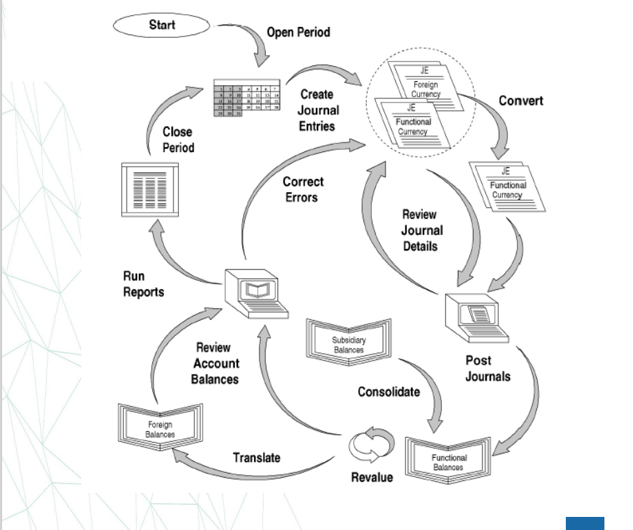
The General Ledger Accounting Cycle

Slide 11





1) Purpose of the Training
Manual Document
The goal of the User Training Manual Documentation is to discuss all the business cycles applied in the Document in more details to be considered as a guide for the user with more details of the operation which he is responsible for.

Slide 12

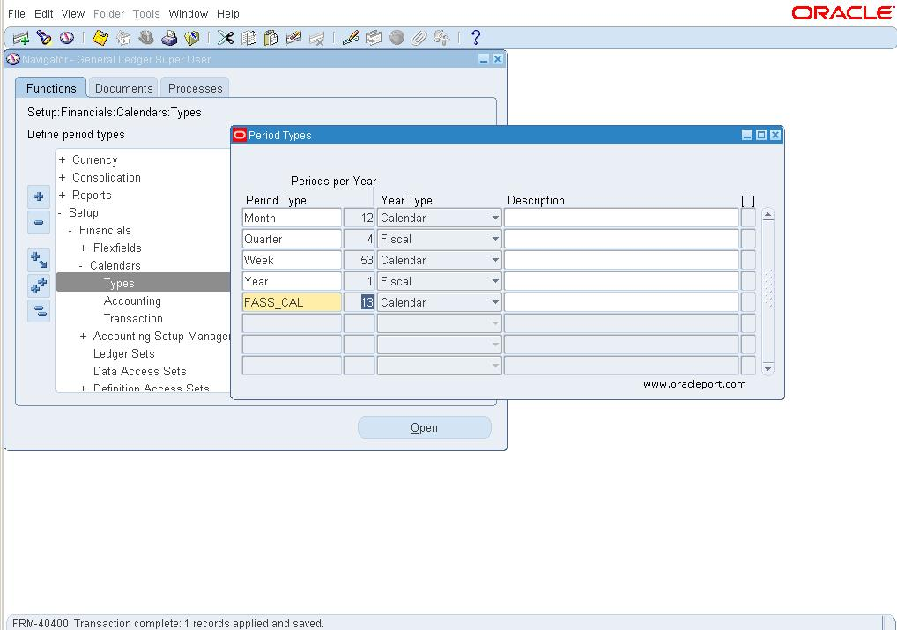
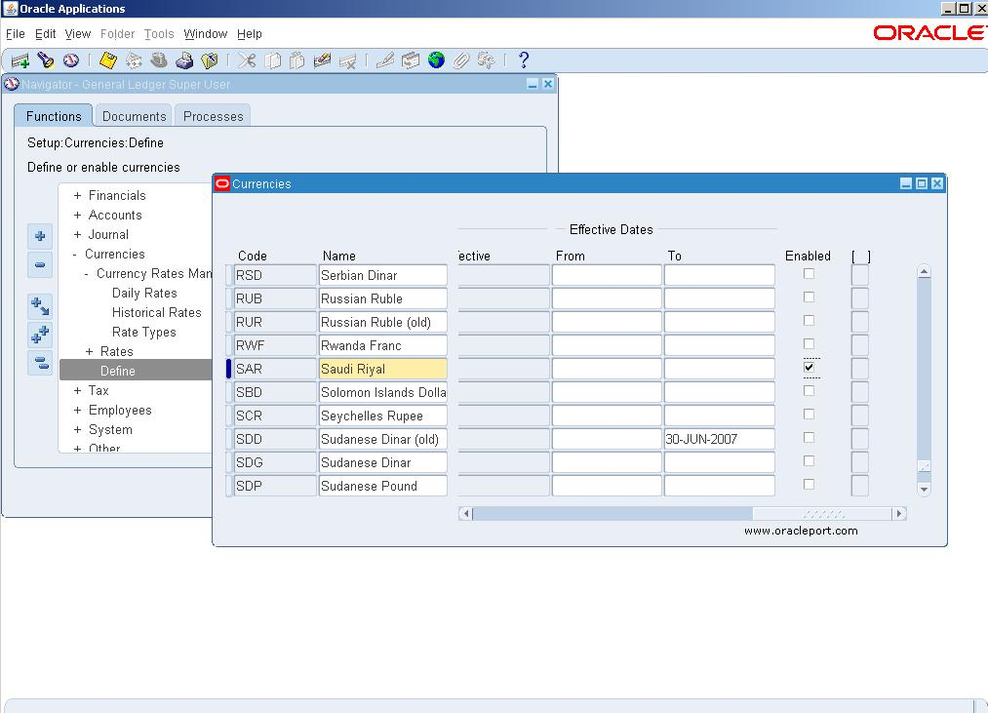
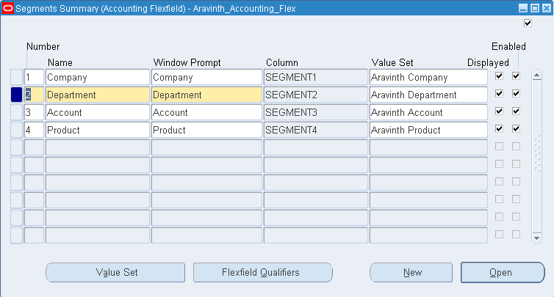
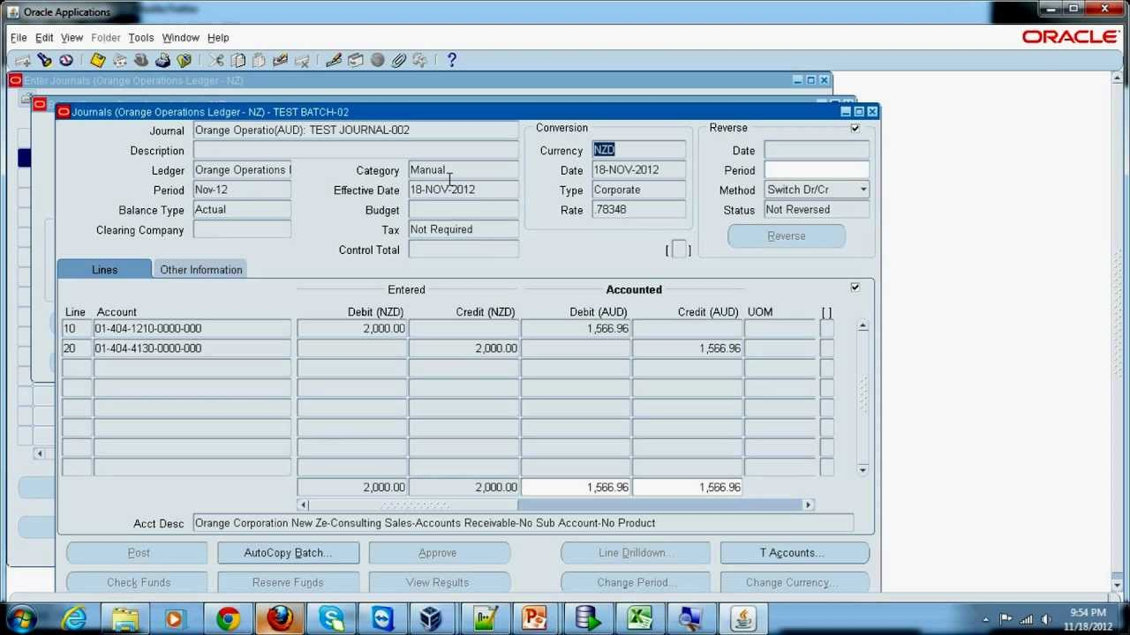
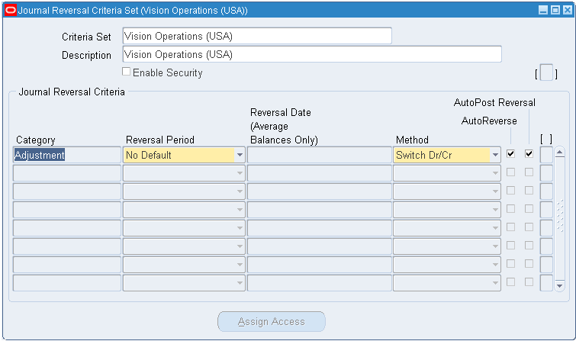
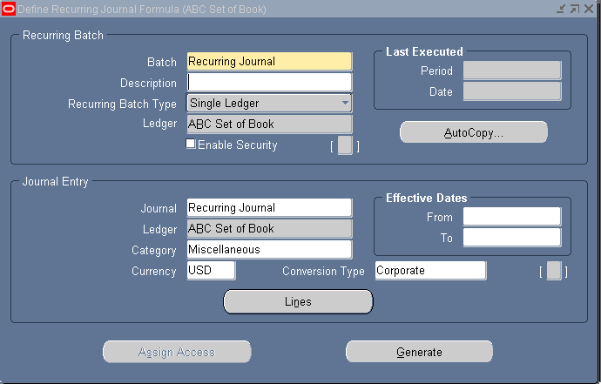
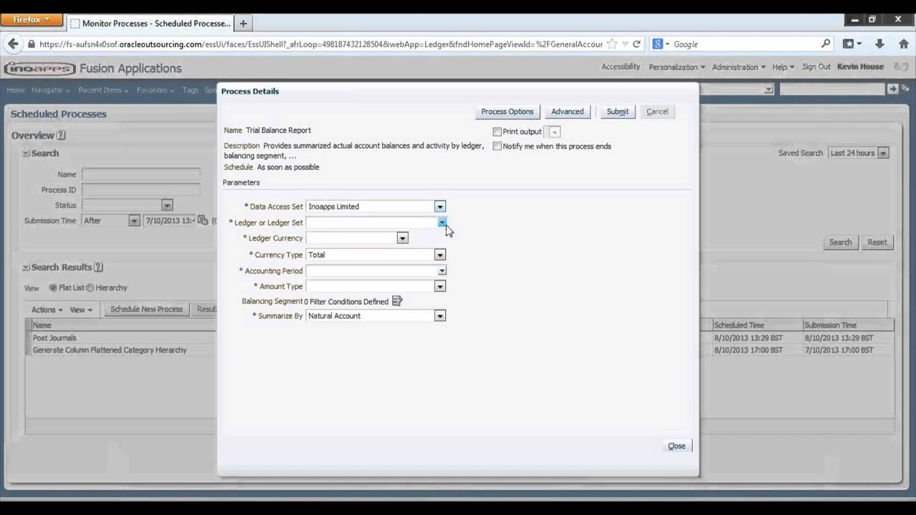
2) Definition & setup

Slide 13
2) Definition & setup
Fiscal Year Setup
Process ID: 2.1

Slide 14
Currency
Process ID: 2.2

Slide 15
Chart of Accounts
Process ID: 2.3

Slide 16
3) Operation
Create General Journal:
Process ID: 3.1

Slide 17
3) Operation
Transaction Reversal:
Process ID: 3.2

Slide 18
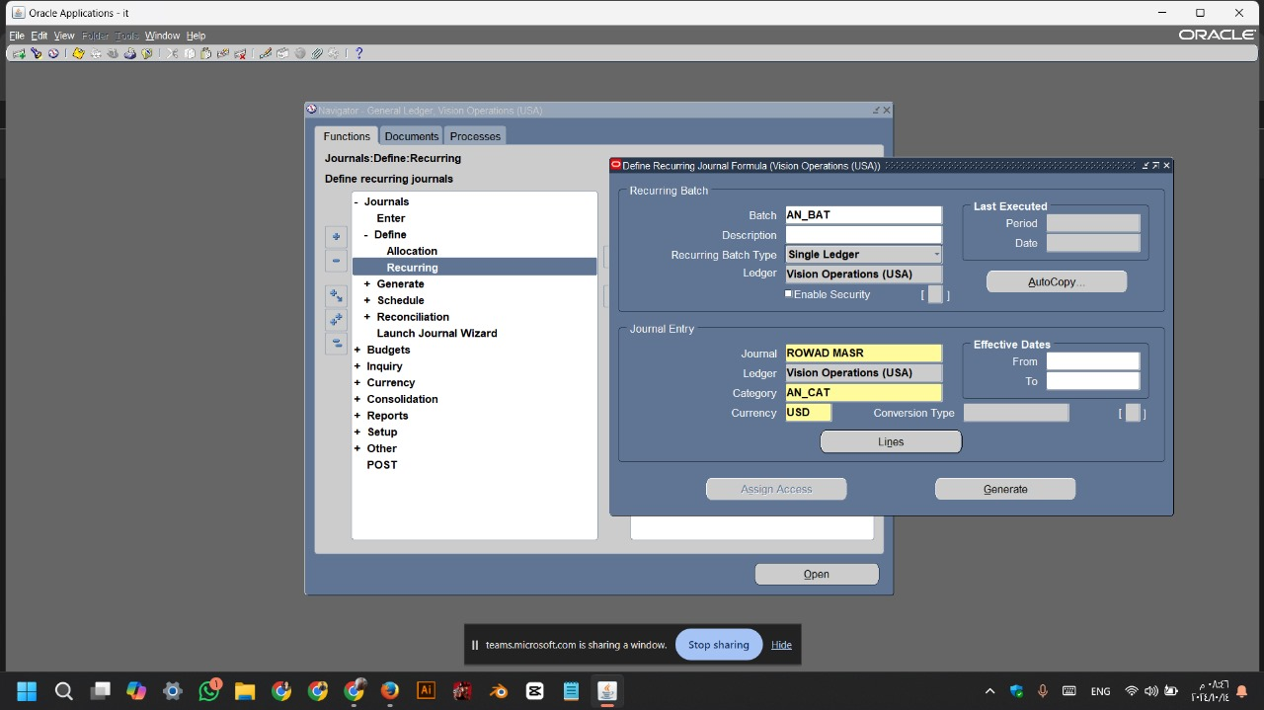
3) Operation
Create Recurring Journal:
Process ID: 3.3

Slide 19
4) Reports
Trial Balance:
Process ID: 4.1

Slide 20
LET’S START

Slide 21
5
Money
Ajd aljfh aj laj fnfm j s m,gfs nj s nvsfjdk v vnfjsldvn
1
Money
Ajd aljfh aj laj fnfm j s m,gfs nj s nvsfjdk v vnfjsldvn
Main
Title
2
Fiscal Year Setup (2.1)
Money
Ajd aljfh aj laj fnfm j s m,gfs nj s nvsfjdk v vnfjsldvn
3
Money
Ajd aljfh aj laj fnfm j s m,gfs nj s nvsfjdk v vnfjsldvn
4
Money
Ajd aljfh aj laj fnfm j s m,gfs nj s nvsfjdk v vnfjsldvn

Slide 22
Process Description:
• Steps:
1
5
Process Description:
Process ID Description
Step Introduction:
• This is to define new fiscal period
Fiscal Year Setup
• Steps:
Fiscal Year Setup (2.1)
2
Persons
• Key user
• Chief Accountant
• End User
3
4
Roles
Frequency
• Define new fiscal year
• Implementation
• As Needed

Slide 23
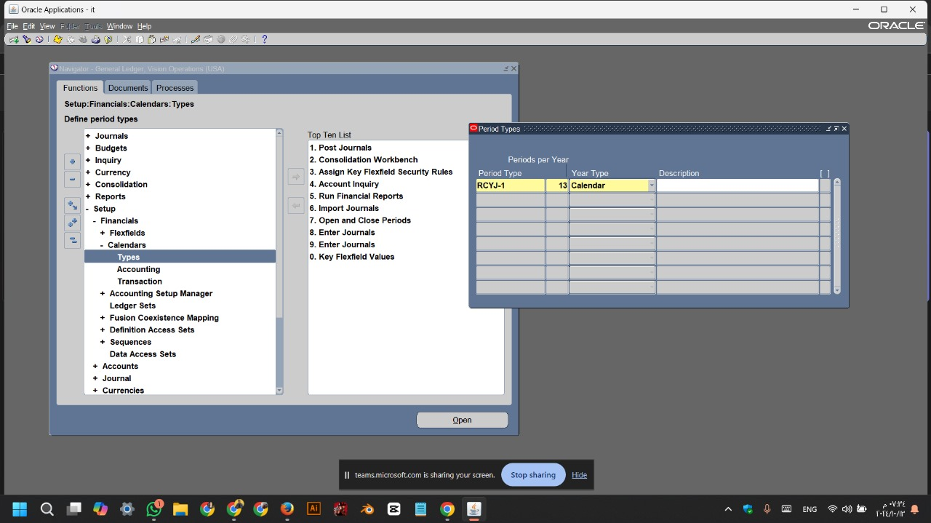
Process Description:
Oracle Screen:
• Steps:

Slide 24
Process Description:
Oracle Screen:
• Steps:
Navigate to the Calendar Setup:
• Go to the Setup menu.
• Select Financials.
• Click on Calendars and then
select Types.
:

Slide 25
Process Description:
Oracle Screen:
• Steps:
Periods Per Year:
• Period Type RCYJ-1
• 13
• Year Type Calendar
• Finally CTRL+S (Save)
:

Slide 26


Slide 27
• Through Fiscal Calendars form in Oracle, you can create many calendars. You have to assign certain fiscal calendar which will be used for the company through another screen called Ledger.
(The ledger Screen will be explained in details in a separate point in this document).
• Procedures to Create a New Fiscal Year and Periods in a new Fiscal Calendar as

Slide 28
Review New Periods:
• Based on the values entered in the Create new fiscal year form, fiscal year information is displayed in the Periods form.
• oracel always creates two additional periods:
o An opening period to which opening balance transactions are transferred from the year-end closing process. The opening transactions result from the previous years’ balance accounts.

Slide 29
o A closing period to which closing transactions will be posted.
• The following information are displayed in the fields of the Periods form:
• Period Name: This field specifies the period sequence.
• Number of period: 13

Slide 30
o Type: This field is specified automatically by the system based on the setup of periods. The possible values are:
• Opening: to which opening balance transactions are transferred from the year-end closing process. The opening transactions result from the previous years’ balance accounts.
• Operating: Operating periods are the periods used to enter and post transactions on.
• Closing: Closing periods are those periods to which closing transactions will be posted.

Slide 31
o Period Start: This field specifies the beginning date of the period.
o End Date: This indicates the end date of the period.
o Month: This field specifies which month the period found in

Slide 32
5
Money
Ajd aljfh aj laj fnfm j s m,gfs nj s nvsfjdk v vnfjsldvn
1
Money
Ajd aljfh aj laj fnfm j s m,gfs nj s nvsfjdk v vnfjsldvn
Main
Title
2
Money
Currency
(2.2)
Ajd aljfh aj laj fnfm j s m,gfs nj s nvsfjdk v vnfjsldvn
3
Money
Ajd aljfh aj laj fnfm j s m,gfs nj s nvsfjdk v vnfjsldvn
4
Money
Ajd aljfh aj laj fnfm j s m,gfs nj s nvsfjdk v vnfjsldvn

Slide 33
Process Description:
• Steps:
1
5
Process Description:
Process ID Description
Step Introduction:
• Setup company currencies, Exchange
Rate Types, Exchange Rates and
Currency revaluation Accounts.
• Steps:
Currency
2
Currency
(2.2)
Persons
• Key user
• Chief Accountant
• End User
3
4
Roles
Frequency
• Define currency
• Change Exchange rate
• Implementation
• As Needed

Slide 34
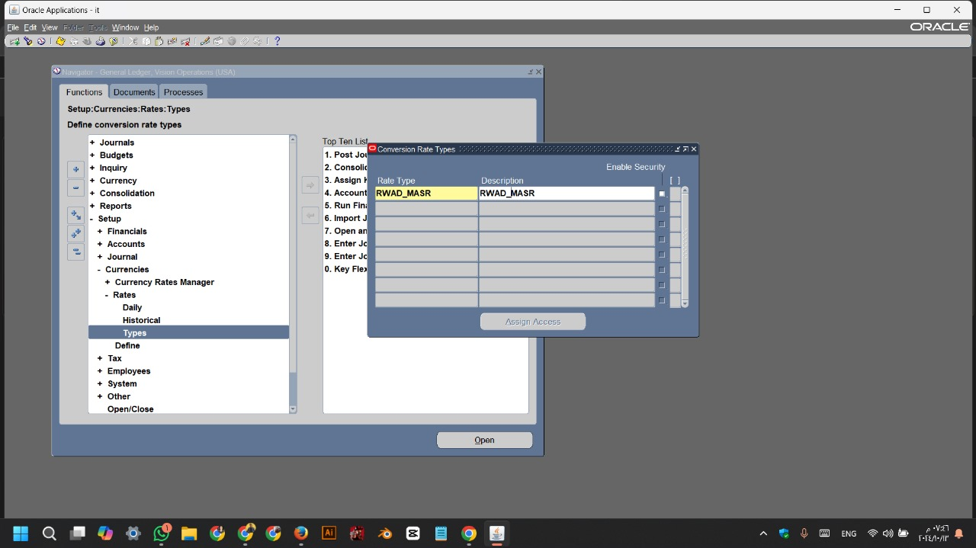
Process Description:
Oracle Screen:
• Steps:

Slide 35
Process Description:
Oracle Screen:
• Steps:
Navigate to Currency Rate Types:
• Go to the Setup menu
• Select Currencies
• Click on Rate Types

Slide 36
Process Description:
Oracle Screen:
• Steps:
Conversation Raye Type:
• Rate Type RWAD_MASR
• Description RWAD_MASR
• Finally CTRL+S (Save)
:

Slide 37
Process Description:
Oracle Screen:
• Steps:

Slide 38
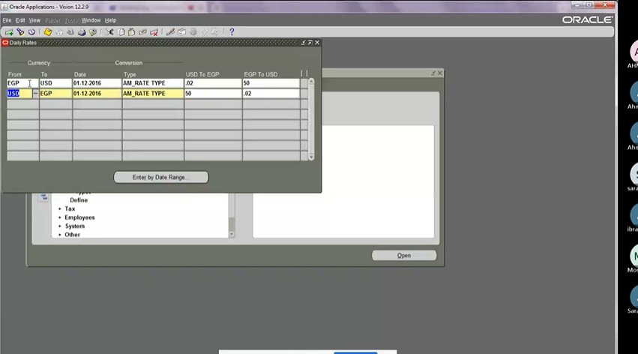

Process Description:
Oracle Screen:
• Steps:
Navigate to Currency Rate Types:
• Go to the Setup menu
• Select Currencies
• Click on Dailly

Slide 39


Process Description:
Oracle Screen:
• Steps:
Dailly Rates:
Line 1:
• From EGP To USD
• Date 01-12-2016 Type AM_RATE_TYPE
• USD To EGP 0.02
• EGP To USD 50
:

Slide 40
Process Description:
Oracle Screen:
• Steps:
Dailly Rates:
Line 2:
• From USD To EGP
• Date 01-12-2016 Type AM_RATE_TYPE
• USD To EGP 50
• EGP To USD 0.02
• Finally CTRL+S (Save)
:

Slide 41
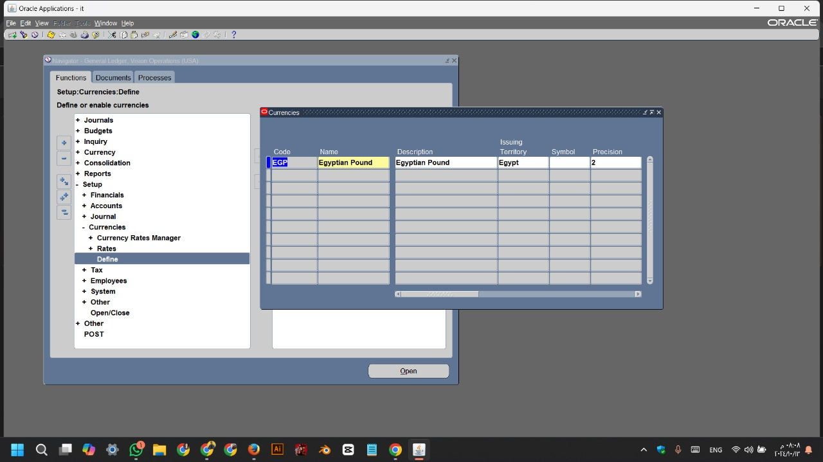
Process Description:
Oracle Screen:
• Steps:

Slide 42
Process Description:
Oracle Screen:
• Steps:
Navigate to Currency Definitions:
• Go to the Setup menu
• Select Currencies
• Click on Define

Slide 43
Process Description:
Oracle Screen:
• Steps:
Currencies:
• Code EGP
• Name Egyptian Pound
• Description Egyptian Pound
• Issuing Territory Egypt
• Precision 2
• Finally CTRL+S (Save)

Slide 45
Currency and Exchange Rate setup:
• Oracle can support multiple currencies and multiple Exchange rate types to cover the business needs
Currency Revaluation Accounts:
• Setup the accounts to track profit and loss caused by exchange rate fluctuation on the exchange rate as shown below in Figure
1) To Access the Currency Revaluation Accounts form
2) Select a currency.

Slide 46
3) Specify the following ledger accounts to track currency profit and loss:
o Realized Gain: The account number in the ledger for posting realized profit in the current currency. This is calculated when settlement occurs.
o Realized loss - The account number in the ledger for posting realized loss in the current currency. This is calculated when settlement occurs.

Slide 47
o Unrealized gain - The account number in the ledger for posting unrealized profit in the current currency. This is calculated when an Exchange adjustment (Currency Revaluation Process) is processed.
o Unrealized loss - The account number in the ledger for posting unrealized loss in the current currency. This is calculated when an Exchange Adjustment (Currency Revaluation Process) is processed.

Slide 48
5
Money
Ajd aljfh aj laj fnfm j s m,gfs nj s nvsfjdk v vnfjsldvn
1
Money
Ajd aljfh aj laj fnfm j s m,gfs nj s nvsfjdk v vnfjsldvn
Main
Title
2
Chart of Accounts
(2.3)
Money
Ajd aljfh aj laj fnfm j s m,gfs nj s nvsfjdk v vnfjsldvn
3
Money
Ajd aljfh aj laj fnfm j s m,gfs nj s nvsfjdk v vnfjsldvn
4
Money
Ajd aljfh aj laj fnfm j s m,gfs nj s nvsfjdk v vnfjsldvn

Slide 49
Process Description:
• Steps:
3
1
Roles
• Define new Ledger Accounts
• Specified the locked accounts in journals
• Assign the GL account with it offset account
• Set a fixed currency on account
Process ID Description
Chart of Accounts
Chart of Accounts
(2.3)
2
Persons
4
• Key user
• Chief Accountant
Process Description:
Step Introduction:
• This to define new ledger account
o 1000 (Assets)
o 2000 (Liabilities)
o 3000 (Owners Equity)
o 4000 (Revenue)
o 5000 - 6000 (Expenses)

Slide 51
Through Chart of Accounts form in Oracle, you can create many Charts of Accounts, which are shared between all the branches. You have to assign the COA that you will use for every company through another screen called Ledger.
- General Tab Definitions:
Select the Account Type in the Main Account Type Field. The types are as defined below:

Slide 52
a. Profit and Loss: To record revenue and expenses. The sum of all operating accounts determines the year-end results.
i. Revenue: for the accounts which are of type “Revenue” and cannot be expenses.
ii. Expense: for the accounts which are of type “Expense” and cannot be Revenues.
b. Balance Sheet: Balance account resembles a transaction account. Use it to record assets, liabilities or equity transactions.
i. Assets: for the Account type “Asset” with all asset types
ii. Liability: for the Liability accounts only
iii. Equity: for the Owner’s Equity accounts
c. Total: Use this to add account intervals. For example, frequently it is useful to make a total of a range of revenue accounts to obtain a quick overview of the total sales for the current period

Slide 53
5
Money
Ajd aljfh aj laj fnfm j s m,gfs nj s nvsfjdk v vnfjsldvn
1
Money
Ajd aljfh aj laj fnfm j s m,gfs nj s nvsfjdk v vnfjsldvn
(3) Operation
Main
Title
2
Money
Create General Journal
(3.1)
Ajd aljfh aj laj fnfm j s m,gfs nj s nvsfjdk v vnfjsldvn
3
Money
Ajd aljfh aj laj fnfm j s m,gfs nj s nvsfjdk v vnfjsldvn
4
Money
Ajd aljfh aj laj fnfm j s m,gfs nj s nvsfjdk v vnfjsldvn

Slide 54
Process Description:
• Steps:
1
5
Process Description:
Process ID Description
Step Introduction:
• Create General Journal from GL.
• Steps:
Create General Journal
2
Create General Journal
(3.1)
Persons
• Accountant
3
4
Roles
Frequency
• Create General Journal
• Daily Procedure.
• As Needed

Slide 55
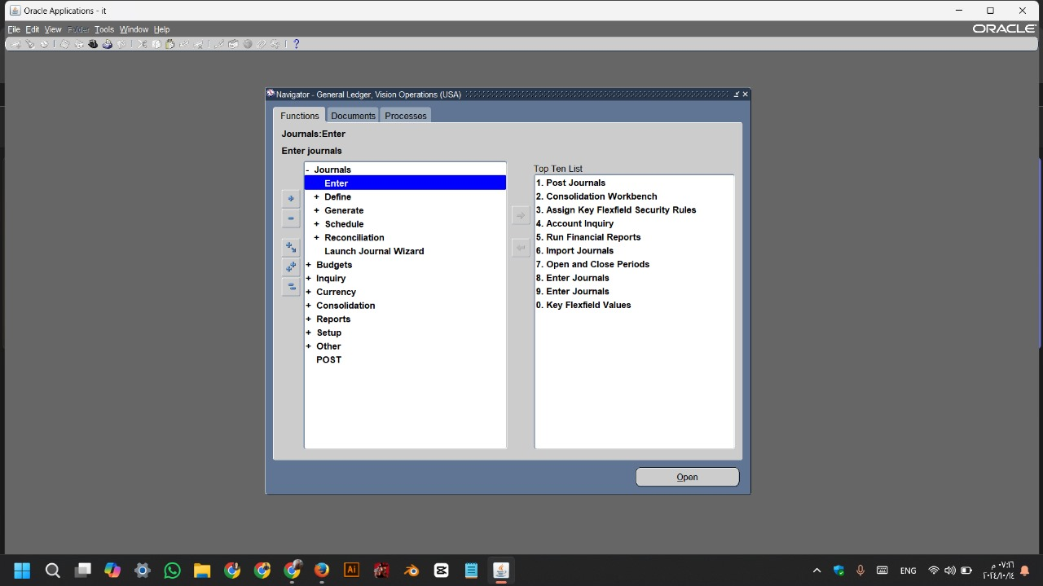
Process Description:
Oracle Screen:
• Steps:

Slide 56
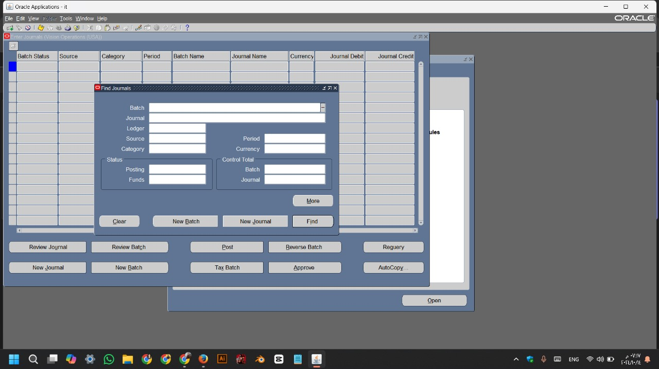
Process Description:
Oracle Screen:
• Steps:
Navigate to the General Ledger Module:
• From the main menu
• navigate to the General
Ledger module
• Go to the Journals
• Click on Enter

Slide 57
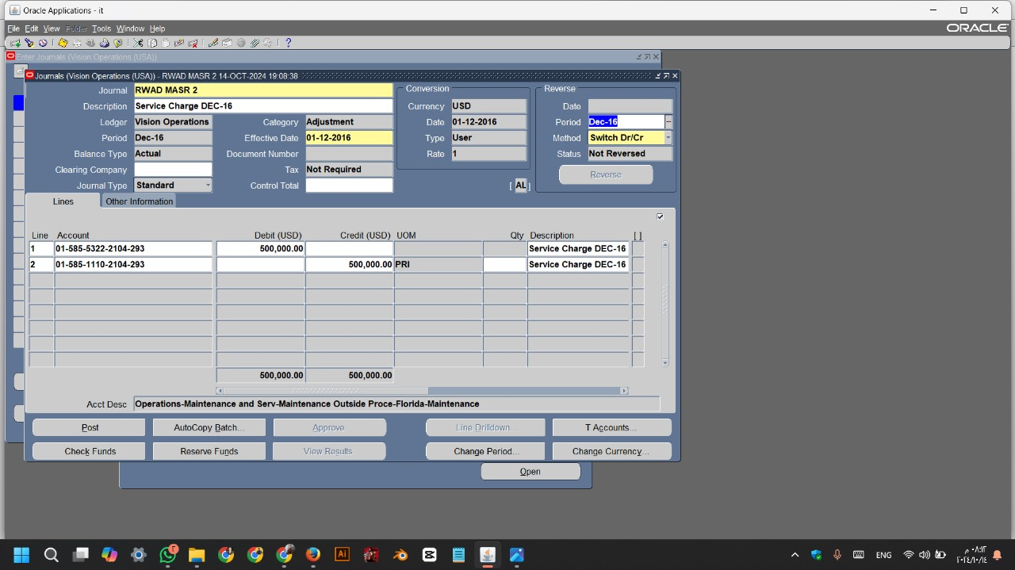
Process Description:
Oracle Screen:
• Steps:
Find Journal:
• Click on New Journal

Slide 58
Process Description:
Oracle Screen:
• Steps:
Journals:
• Journal RWAD MASR 2
• Description Service Charge DEC-16
• Period DEC-16
• Effective Date 01-12-2016
Conversation:
• Date 01-12-2016
:

Slide 59
Process Description:
Oracle Screen:
• Steps:
Line 1:
• Line 1
• Account 01-585-5322-2104-293
• Debit 500,000.00
• Description Service Charge DEC-16
:

Slide 60
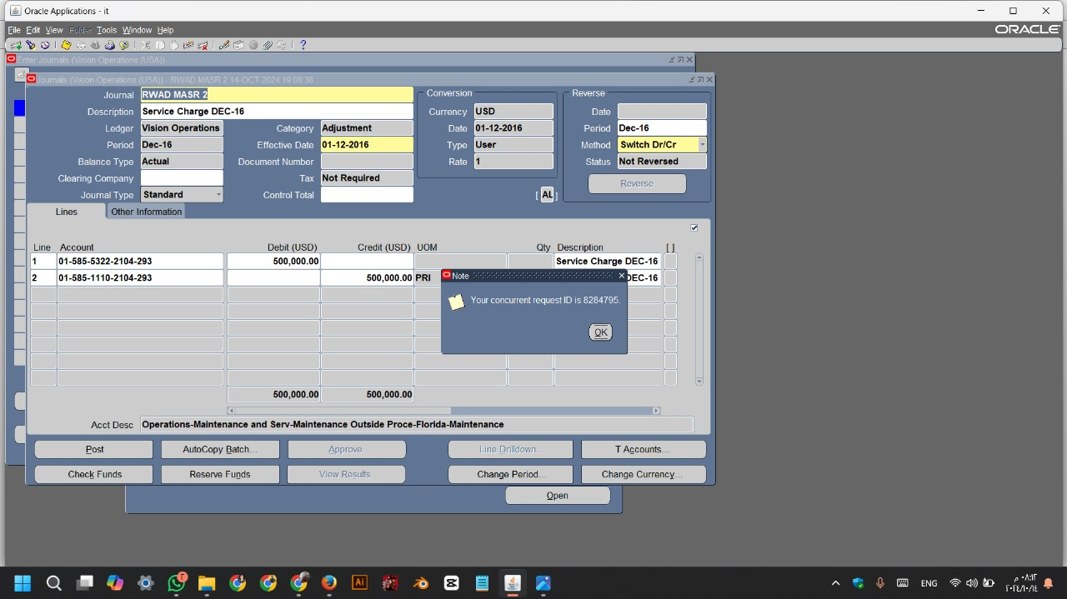
Process Description:
Oracle Screen:
• Steps:
Line 2:
• Line 2
• Account 01-585-1110-2104-293
• Credit 500,000.00
• Description Service Charge DEC-16
• Finally CTRL+S (Save):

Slide 61
Process Description:
Oracle Screen:
• Steps:
Journal:
• Click on Post
• Your concurrent request ID
is 8284795
Report:
• View < Request
:

Slide 63
• From the overview tab, you can all basic journal information:
1- Date.
2- Voucher number (If not setup to be auto generated)
3- Account Type.
4- Account.
5- Description.
6- Amount (debit or credit)
7- Offset Account type.
8- Offset account.

Slide 64
Procedures to enter general ledger transaction:
1- Select the account type for the general ledger transaction:
a. Ledger: Use ledger for transaction in ledger account.
b. Customer: Use customer for transaction in customers.
c. Vendor: Use Vendor for transaction to a vendor.
d. Projects: Use project to specify a posting to project.
e. Fixed Asset: use Fixed asset in order to post to Fixed asset.
f. Bank: use Bank to post transaction to specified bank.

Slide 65
2- Enter account number that you need to post transaction in.
3- Enter a text in the description Field.
4- Enter a debit amount in the given currency.
5- Enter a credit amount in the given currency.
6- Select the offset account type for the offset account.

Slide 66
5
Money
Ajd aljfh aj laj fnfm j s m,gfs nj s nvsfjdk v vnfjsldvn
1
Money
Ajd aljfh aj laj fnfm j s m,gfs nj s nvsfjdk v vnfjsldvn
(3) Operation
Main
Title
2
Money
Transaction Reversal
(3.2)
Ajd aljfh aj laj fnfm j s m,gfs nj s nvsfjdk v vnfjsldvn
3
Money
Ajd aljfh aj laj fnfm j s m,gfs nj s nvsfjdk v vnfjsldvn
4
Money
Ajd aljfh aj laj fnfm j s m,gfs nj s nvsfjdk v vnfjsldvn

Slide 67
Process Description:
• Steps:
1
5
Process Description:
Process ID Description
Step Introduction:
• Create a reverse transaction.
• Steps:
Transaction Reversal
2
Transaction Reversal
(3.2)
Persons
• Accountant
3
4
Roles
Frequency
• Reverse a transaction
.• As Needed

Slide 68
Process Description:
• Steps:
To reverse an entire journal batch:
Navigate to the Enter Journals window.
Query the batch you want to reverse.
Choose Review Batch.
Choose More Actions.
Choose Reverse Batch to generate unposted reversal batches for each entry.....
Choose OK, then enter a reversal method: ...
Post the reversing journal batches.
:

Slide 70
Procedure to reverse transaction:
• Transaction Reversal is being done from the module which generates the transaction.
• Some transaction cannot be reversed and need to do manual reverse entry.

Slide 71
5
Money
Ajd aljfh aj laj fnfm j s m,gfs nj s nvsfjdk v vnfjsldvn
1
Money
Ajd aljfh aj laj fnfm j s m,gfs nj s nvsfjdk v vnfjsldvn
(3) Operation
Main
Title
2
Money
Create Recurring Journal
(3.3)
Ajd aljfh aj laj fnfm j s m,gfs nj s nvsfjdk v vnfjsldvn
3
Money
Ajd aljfh aj laj fnfm j s m,gfs nj s nvsfjdk v vnfjsldvn
4
Money
Ajd aljfh aj laj fnfm j s m,gfs nj s nvsfjdk v vnfjsldvn

Slide 72
Process Description:
• Steps:
1
5
Process Description:
Process ID Description
Step Introduction:
• Create a Periodic transaction.
• Steps:
Create Recurring Journal
2
Create Recurring Journal
(3.3)
Persons
• Accountant
3
4
Roles
Frequency
• Create and retrieve
periodic journals
.• As Needed

Slide 73
Process Description:
Oracle Screen:
• Steps:

Slide 74
Process Description:
Oracle Screen:
• Steps:
Open the Journals Window:
• Select Journals from the menu.
• click on Define Then Recurring.

Slide 75
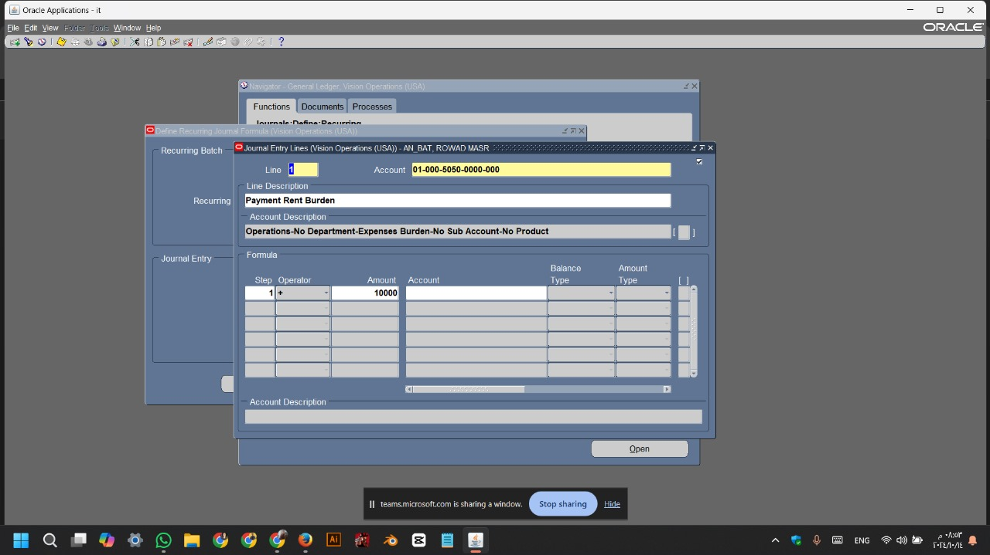
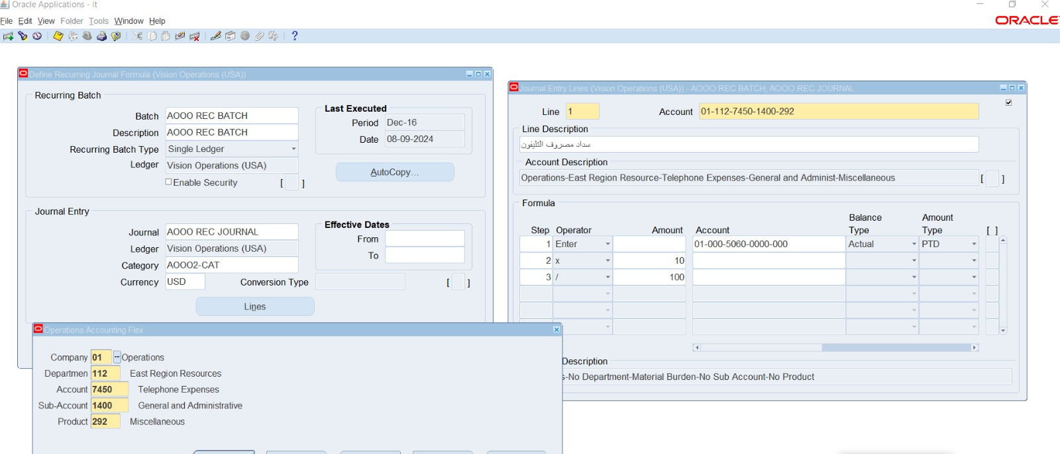
Process Description:
Oracle Screen:
• Steps:
Recurring Batch:
• Batch AN_BAT
Journal Entry:
• Journal RWAD MASR
• Category AN_CAT
• Currency USD
click on Lines

Slide 76

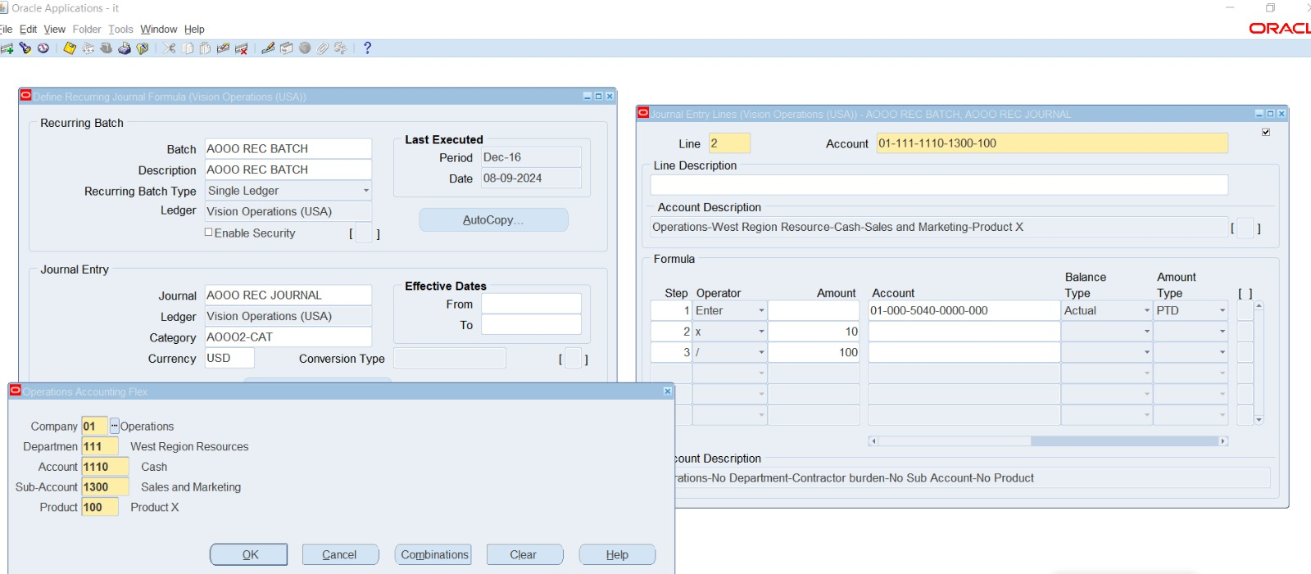
Process Description:
Oracle Screen:
• Steps:
Line 1:
• Line 1
• Account 01-112-7450-1400-292
• Description Payment of telephone money
Formula:
• Step 1 • Step 2 • Step 2
• Operator Enter • Operator *
• Operator /

Slide 77
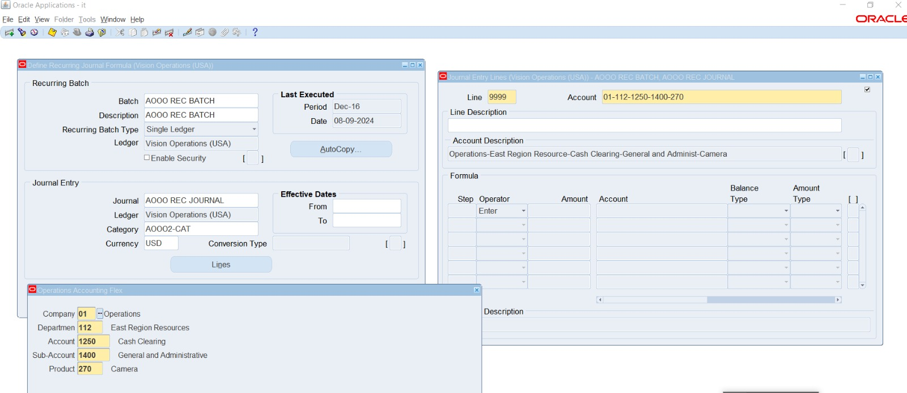
Process Description:
Oracle Screen:
• Steps:
• Stand on the line and then
go down on the arrow to open a new line
Line 2:
• Line 2
• Account 01-111-1110-1300-100
Formula:
• Step 1 • Step 2 • Step 3
• Operator Enter • Operator *
• Operator /

Slide 78
Process Description:
Oracle Screen:
• Steps:
Line 999:
• Line 999
• Account 01-112-1250-1400-270
Formula:
• Step 1
• Operator Enter

Slide 79
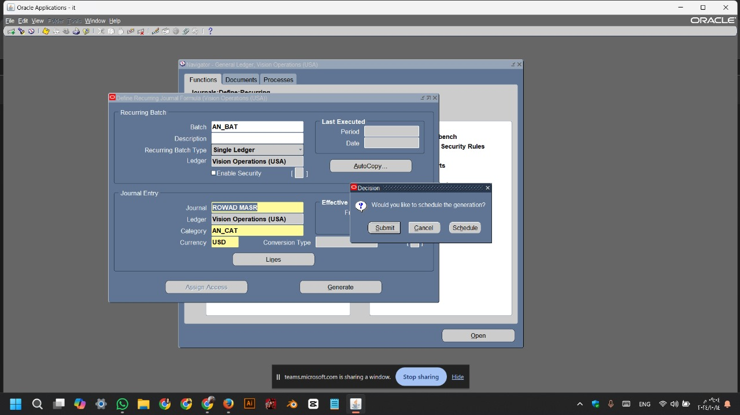
Process Description:
Oracle Screen:
• Steps:
• Back to Define Recurring List
• click on Generate

Slide 80
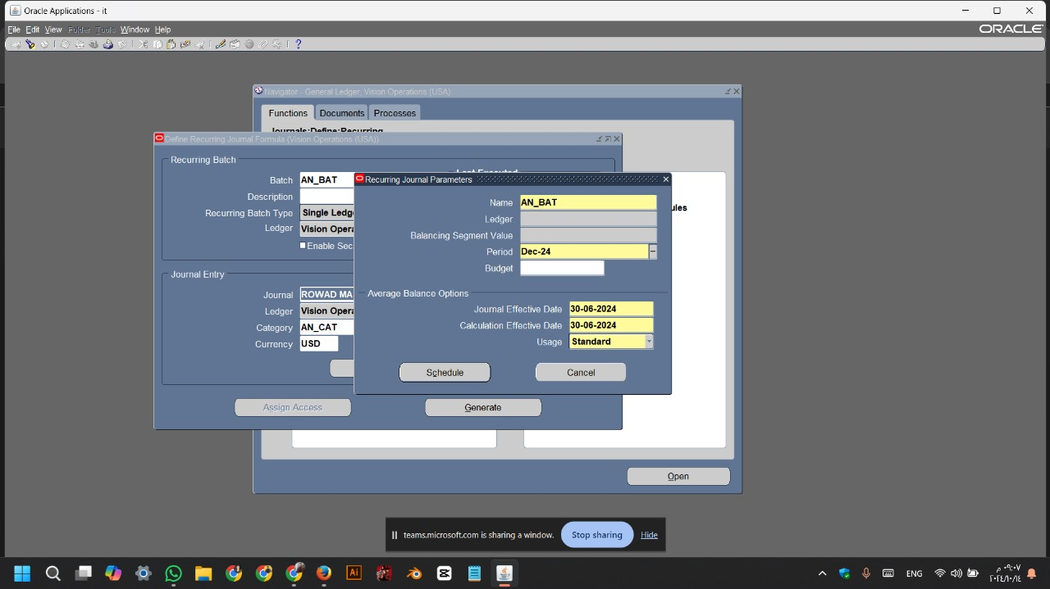
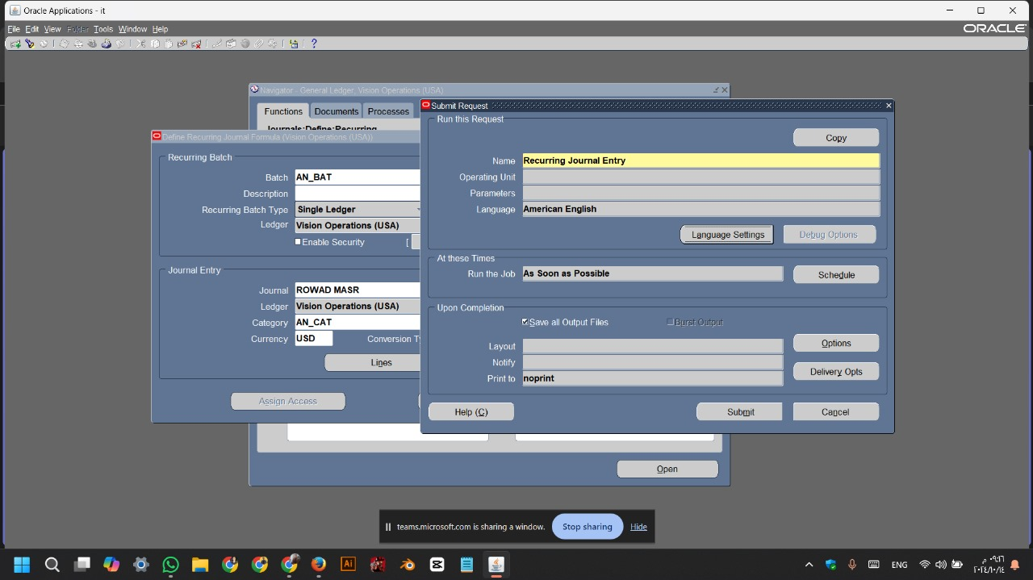
Process Description:
Oracle Screen:
• Steps:
• That message will show you
• click on Schedule

Slide 81
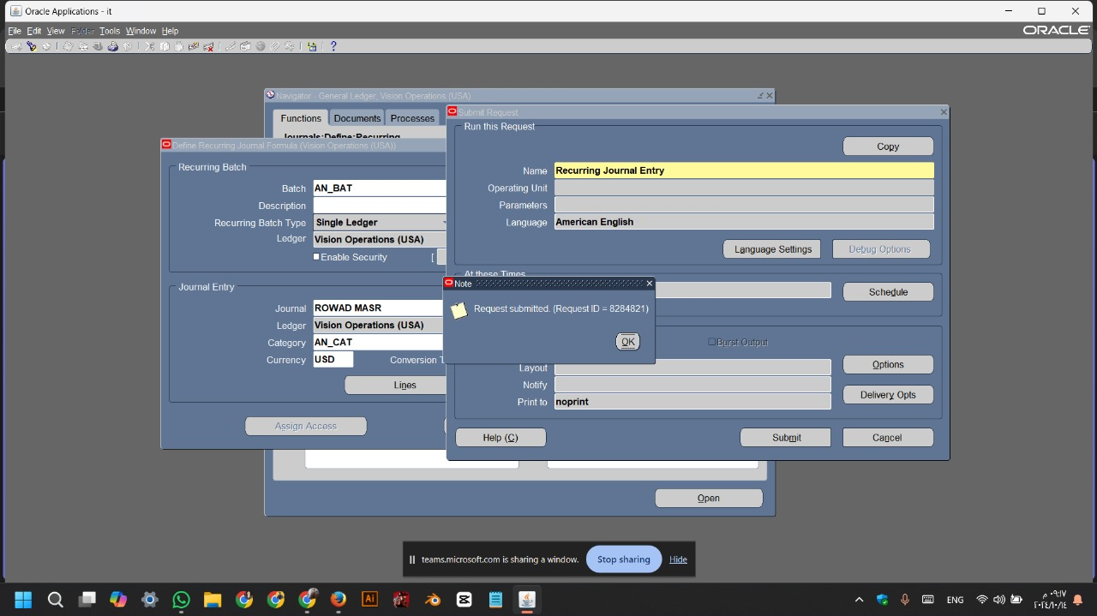
Process Description:
Oracle Screen:
• Steps:
Recurring Journal Parameters:
• Name AN_BAT
• Period Dec-24
• click on Schedule

Slide 82
Process Description:
Oracle Screen:
• Steps:
Submit Request
• click on Submit
• That message will show you
• Your concurrent request ID
is 8284821

Slide 84
• The Periodic Journal is used to enter the transaction details in a periodic form.
• Ex: at the end of each month, the user creates the same transactions to close the month. He uses the same transactions with the same account numbers and same currencies, so he creates the periodic journals to be used periodically and save time and effort. All he has to do at the end of the month is to post the journal.

Slide 85
5
Money
Ajd aljfh aj laj fnfm j s m,gfs nj s nvsfjdk v vnfjsldvn
1
Money
Ajd aljfh aj laj fnfm j s m,gfs nj s nvsfjdk v vnfjsldvn
Main
Title
2
Money
Reports
(4)
Ajd aljfh aj laj fnfm j s m,gfs nj s nvsfjdk v vnfjsldvn
3
Money
Ajd aljfh aj laj fnfm j s m,gfs nj s nvsfjdk v vnfjsldvn
4
Money
Ajd aljfh aj laj fnfm j s m,gfs nj s nvsfjdk v vnfjsldvn

Slide 86
Process Description:
• Steps:
1
Reports
(4)
Process ID Description
Trial Balance

Slide 88
• A trial balance is an accounting report that lists the balances of all ledger accounts at a specific date, ensuring that total debits equal total credits.
• It serves to verify the arithmetic accuracy of the accounts before preparing financial statements.
• The trial balance typically includes two columns—one for debits and one for credits—and is prepared at the end of an accounting period.
• While it helps identify some errors, it cannot detect all types of discrepancies.

